Slide 1

Date: | 10 October 2020
Course Name: | Working with Hiring and HR Systems
Module #: | 1
Module Section Title (Subtopic): | Introduction
Slide/Screen Title: | Working with Hiring and HR Systems
Navigation Notes: | A button invites learners to begin the course. The button will read “Begin Course.”
Graphics and Slide Text:
Narration/Voiceover: Welcome to “Working with Hiring and HR Systems!” Click “Begin Course” to get started.
Animation: “Begin Course” button glows or pulses. One of the course host figures could be waving.
Notes:
Clean Version

Slide 2
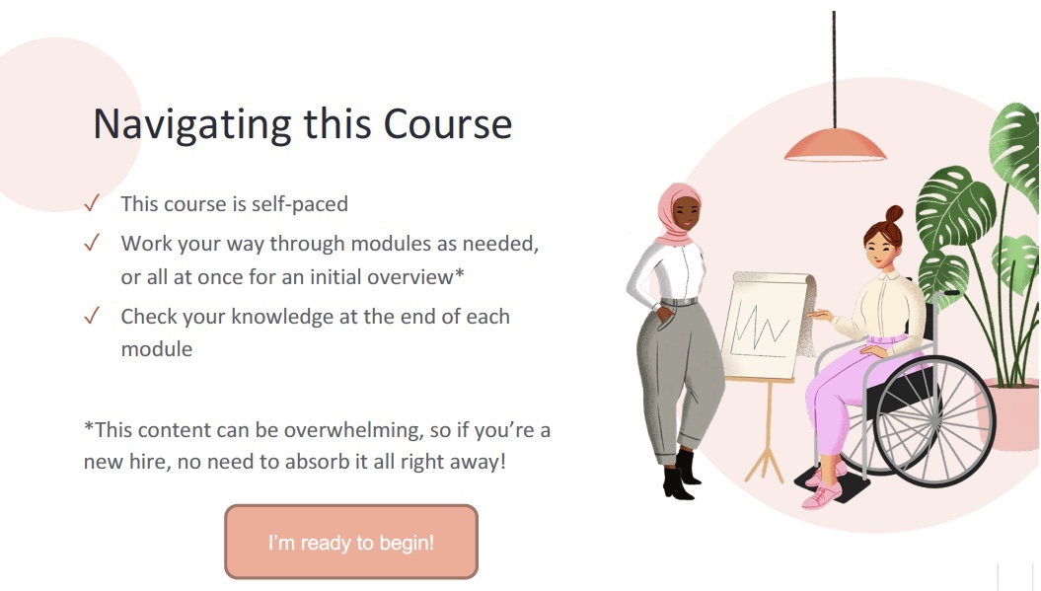
Date: | 10 October 2020
Course Name: | Working with Hiring and HR Systems
Module #: | 1
Module Section Title (Subtopic): | Introduction
Slide/Screen Title: | Navigating this Course
Navigation Notes: | A button will read “I’m ready to begin!” and it will take learners to the next screen of the Introduction. A “main menu” button will allow users to skip the introductory video on the next screen.
Graphics and Slide Text:
Narration/Voiceover: If you’re a new employee, use this course as a broad overview of the HR Information System. Feel free to come back to modules as needed. If you’re ready to use the HRIS, navigate to the main menu and choose your desired module.
Animation: When VO says “new employee,” the “I’m ready to begin!” button glows or pulses. When VO says “If you’re ready…” the “Main Menu” button glows or pulses.
Notes:
Clean Version

Slide 3
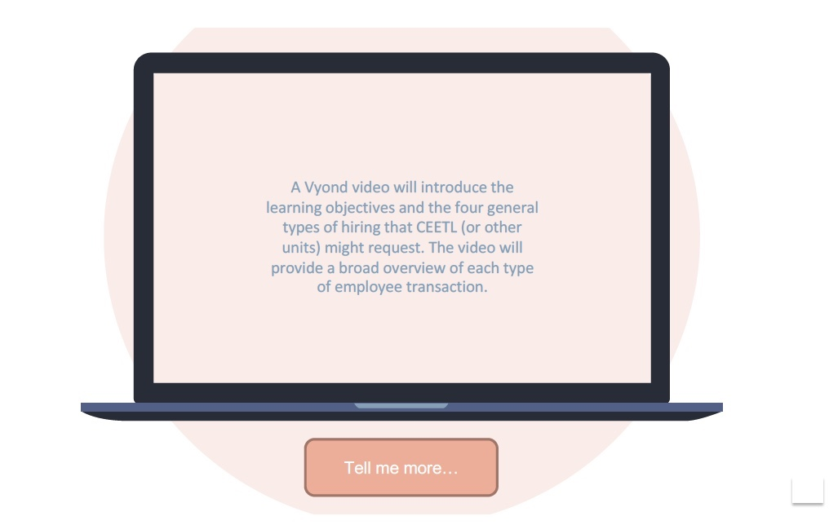
Date: | 10 October 2020
Course Name: | Working with Hiring and HR Systems
Module #: | 1
Module Section Title (Subtopic): | Introduction
Slide/Screen Title: | Common HR Information System Requests
Navigation Notes: | A video will play on this screen, so there will be “pause” and “play” buttons, along with a “Tell me more” button that will advance learners to the next module.
Graphics and Slide Text:
Narration/Voiceover: N/A
Animation: N/A
Notes:
Clean Version

Slide 4
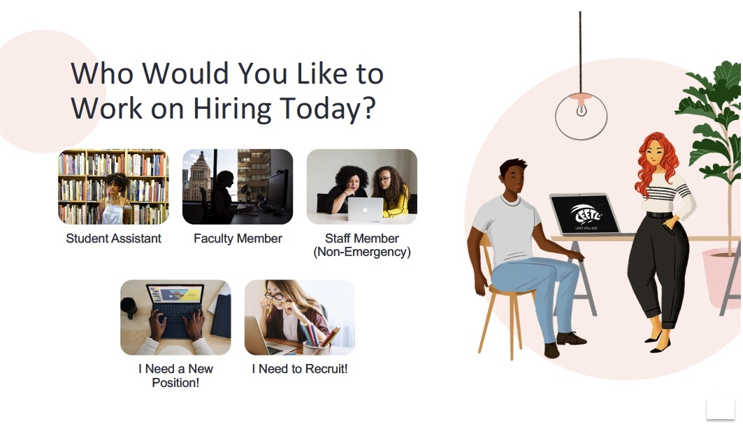
Date: | 10 October 2020
Course Name: | Working with Hiring and HR Systems
Module #: | 2
Module Section Title (Subtopic): | Hiring Student Assistants
Slide/Screen Title: | Who Would You Like to Work on Hiring Today?
Navigation Notes: | This is a branching homepage, where 5 tiles lead to different modules.
Graphics and Slide Text:
Narration/Voiceover: Who would you like to work on hiring today?
Animation: The clickable tiles glow or pulse.
Notes:
Clean Version

Slide 5

Date: | 10 October 2020
Course Name: | Working with Hiring and HR Systems
Module #: | 2
Module Section Title (Subtopic): | Hiring Student Assistants
Slide/Screen Title: | Let’s learn how to hire a student assistant!
Navigation Notes: | The CEETL Beetle will function as the “next” button.
Graphics and Slide Text:
Narration/Voiceover: You chose to learn about hiring a student assistant! Before we learn how to process an E-TRAC, click the CEETL Beetle to learn more about what information you’ll need from a new student assistant.
Animation: One of the characters might wave, and the CEETL Beetle should glow or pulse after scurrying in from left.
Notes:
Clean Version

Slide 6

Date: | 10 October 2020
Course Name: | Working with Hiring and HR Systems
Module #: | 2
Module Section Title (Subtopic): | Hiring Student Assistants
Slide/Screen Title: | Click each tile to learn about the information you need to get started!
Navigation Notes: | Each tile leads to an explanation screen. Once all tiles have been read, a “next” button will appear.
Graphics and Slide Text:
Narration/Voiceover: Click each tile to learn about the information you need to get started!
Animation: The tiles should glow or pulse. One of the characters might gesture or wave.
Notes:
Clean Version

Slide 7
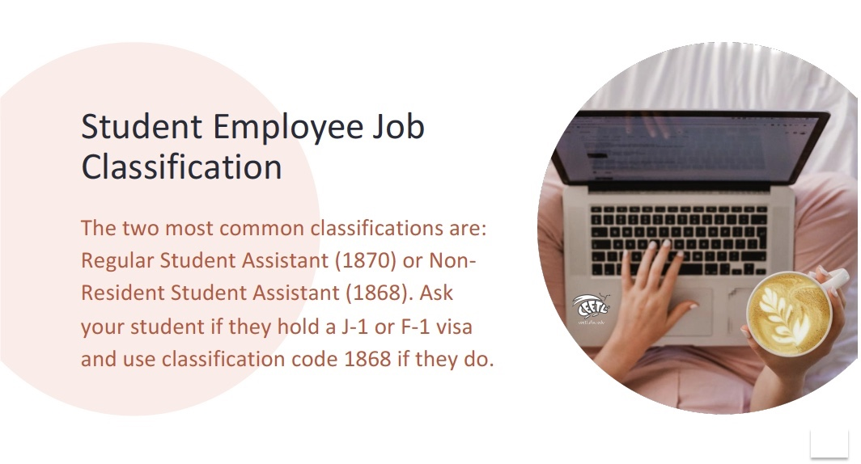
Date: | 10 October 2020
Course Name: | Working with Hiring and HR Systems
Module #: | 2
Module Section Title (Subtopic): | Hiring Student Assistants
Slide/Screen Title: | Student Employee Job Classification
Navigation Notes: | There will be a “return” button that takes learners back to the tile screen.
Graphics and Slide Text:
Narration/Voiceover: N/A
Animation: CEETL Beetle might scurry across the scene to its place on the laptop. Background circle could pop, while text slides from left.
Notes:
Clean Version

Slide 8
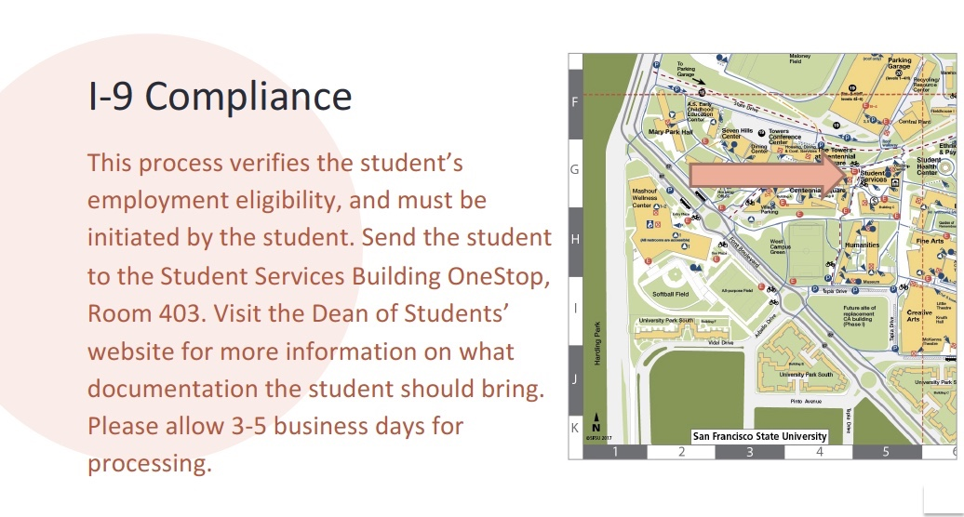
Date: | 10 October 2020
Course Name: | Working with Hiring and HR Systems
Module #: | 2
Module Section Title (Subtopic): | Hiring Student Assistants
Slide/Screen Title: | I-9 Compliance
Navigation Notes: | There will be a “return” button that takes learners back to the tile screen.
Graphics and Slide Text:
Narration/Voiceover: N/A
Animation: Background circle could pop, while text slides from left. Map will be interactive, and arrow will slide from left to show the Student Services Building. When clicked on, a picture of the building will appear in a pop-out.
Notes:
Clean Version

Slide 9
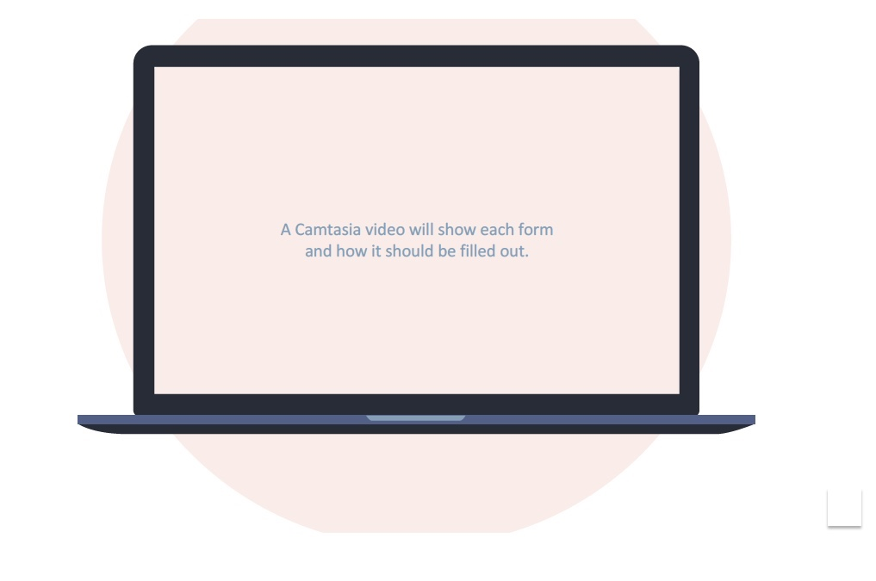
Date: | 10 October 2020
Course Name: | Working with Hiring and HR Systems
Module #: | 2
Module Section Title (Subtopic): | Hiring Student Assistants
Slide/Screen Title: | Hiring Paperwork
Navigation Notes: | There will be a “return” button that takes learners back to the tile screen, in addition to “play” and “pause” buttons.
Graphics and Slide Text:
Narration/Voiceover: N/A
Animation: N/A
Notes:
Clean Version

Slide 10
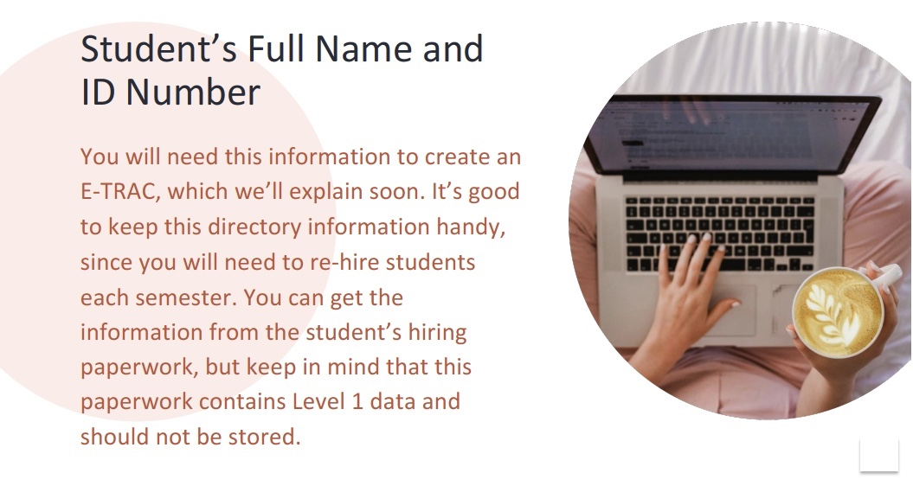
Date: | 10 October 2020
Course Name: | Working with Hiring and HR Systems
Module #: | 2
Module Section Title (Subtopic): | Hiring Student Assistants
Slide/Screen Title: | Student’s Full Name and ID Number
Navigation Notes: | There will be a “return” button that takes learners back to the tile screen.
Graphics and Slide Text:
Narration/Voiceover: N/A
Animation: CEETL Beetle might scurry across the scene to its place on the laptop. Background circle could pop, while text slides from left.
Notes:
Clean Version

Slide 11
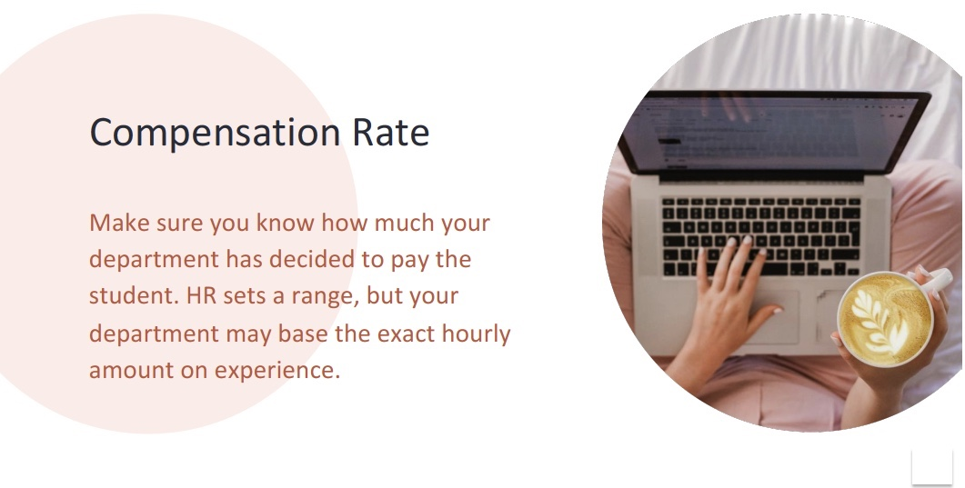
Date: | 10 October 2020
Course Name: | Working with Hiring and HR Systems
Module #: | 2
Module Section Title (Subtopic): | Hiring Student Assistants
Slide/Screen Title: | Compensation Rate
Navigation Notes: | There will be a “return” button that takes learners back to the tile screen.
Graphics and Slide Text:
Narration/Voiceover: N/A
Animation: CEETL Beetle might scurry across the scene to its place on the laptop. Background circle could pop, while text slides from left.
Notes:
Clean Version

Slide 12
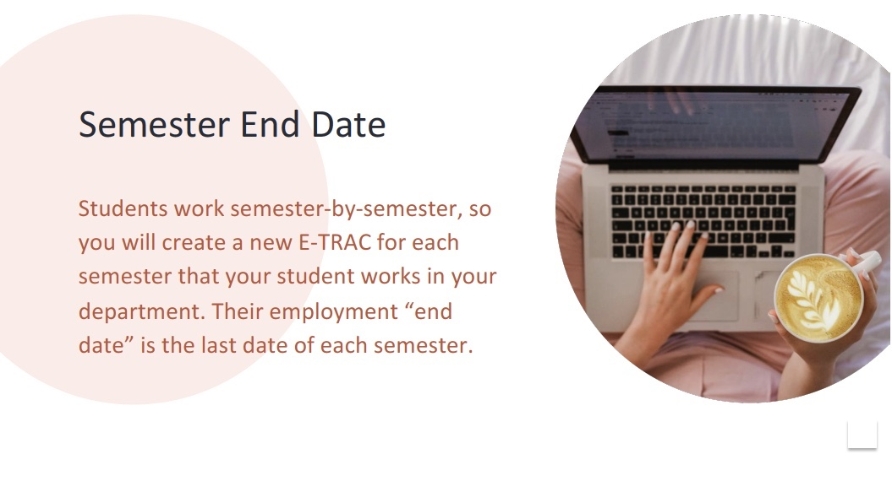
Date: | 10 October 2020
Course Name: | Working with Hiring and HR Systems
Module #: | 2
Module Section Title (Subtopic): | Hiring Student Assistants
Slide/Screen Title: | Semester End Date
Navigation Notes: | There will be a “return” button that takes learners back to the tile screen.
Graphics and Slide Text:
Narration/Voiceover: N/A
Animation: CEETL Beetle might scurry across the scene to its place on the laptop. Background circle could pop, while text slides from left.
Notes:
Clean Version

Slide 13

Date: | 10 October 2020
Course Name: | Working with Hiring and HR Systems
Module #: | 2
Module Section Title (Subtopic): | Hiring Student Assistants
Slide/Screen Title: | Let’s create an E-TRAC!
Navigation Notes: | The CEETL Beetle will act as a “next” button.
Graphics and Slide Text:
Narration/Voiceover: Now you’re ready to see an E-TRAC in action! Click the CEETL Beetle to see a video that walks you through a student assistant E-TRAC.
Animation: One of the characters might wave or gesture. The CEETL Beetle should glow or pulse after scurrying in from left.
Notes:
Clean Version

Slide 14
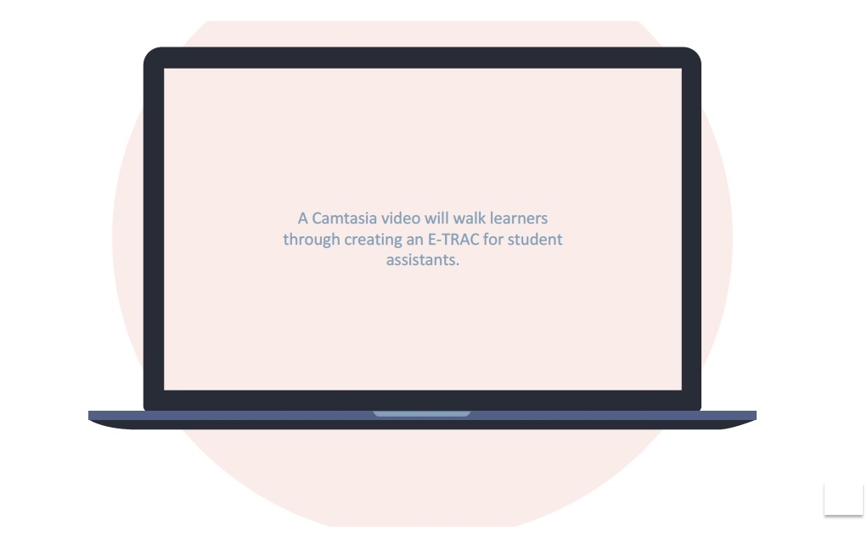
Date: | 10 October 2020
Course Name: | Working with Hiring and HR Systems
Module #: | 2
Module Section Title (Subtopic): | Hiring Student Assistants
Slide/Screen Title: | Creating an E-TRAC for Student Assistants
Navigation Notes: | There will be “play” and “pause” buttons for the video and an “I’ve Got It!” button to advance to the next slide.
Graphics and Slide Text:
Narration/Voiceover: N/A
Animation: N/A
Notes:
Clean Version

Slide 15

Date: | 10 October 2020
Course Name: | Working with Hiring and HR Systems
Module #: | 2
Module Section Title (Subtopic): | Hiring Student Assistants
Slide/Screen Title: | Great work!
Navigation Notes: | The CEETL Beetle will act as a “next” button.
Graphics and Slide Text:
Narration/Voiceover: Now you’ve been introduced to student assistant E-TRACs! Check your knowledge next.
Animation: One of the characters might wave or gesture. The CEETL Beetle should glow or pulse after scurrying in from left.
Notes:
Clean Version

Slide 16
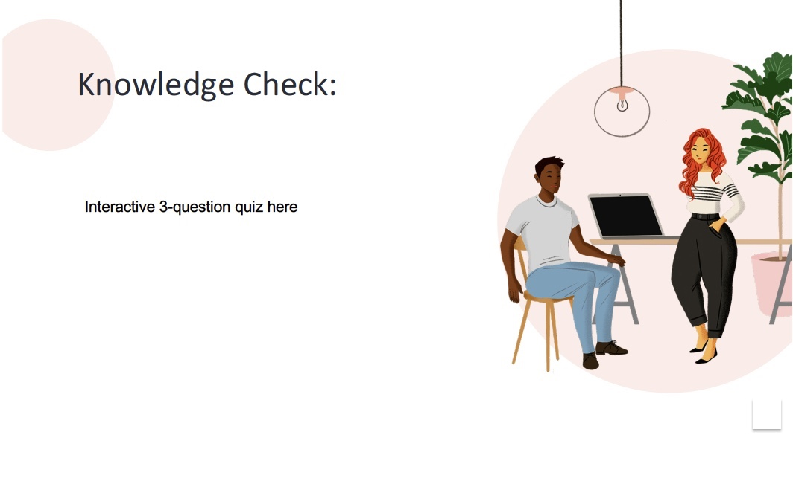
Date: | 10 October 2020
Course Name: | Working with Hiring and HR Systems
Module #: | 2
Module Section Title (Subtopic): | Hiring Student Assistants
Slide/Screen Title: | Knowledge Check
Navigation Notes: | Correct answers will appear green and automatically advance to the next question. Incorrect answers will appear red and automatically trigger an explanation and invitation to try again. The last question will automatically advance to the Hiring Menu.
Graphics and Slide Text:
Narration/Voiceover: N/A
Animation: Text slides in from left. Right answers glow green; wrong answers glow red.
Notes:
Clean Version

Slide 17
Date: | 10 October 2020
Course Name: | Working with Hiring and HR Systems
Module #: | 3
Module Section Title (Subtopic): | Hiring a Faculty Member
Slide/Screen Title: | Who Would You Like to Work on Hiring Today?
Navigation Notes: | This is a branching homepage, where 5 tiles lead to different modules.
Graphics and Slide Text:
Narration/Voiceover: Who would you like to work on hiring today?
Animation: The clickable tiles glow or pulse.
Notes:
Clean Version

Slide 18
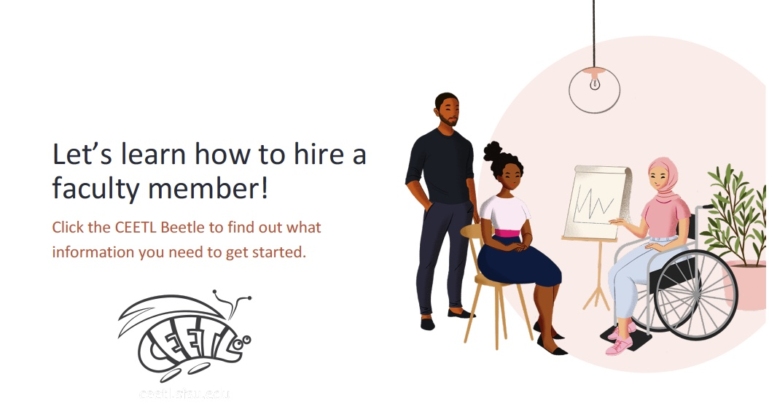
Date: | 10 October 2020
Course Name: | Working with Hiring and HR Systems
Module #: | 3
Module Section Title (Subtopic): | Hiring a Faculty Member
Slide/Screen Title:
Navigation Notes: | The CEETL Beetle will act as a “next” button.
Graphics and Slide Text:
Narration/Voiceover: You chose to learn about hiring a faculty member! Before we learn how to process an E-TRAC, click the CEETL Beetle to learn more about what information you’ll need from a faculty member.
Animation: One of the characters might wave or gesture. The CEETL Beetle should glow or pulse after scurrying in from left.
Notes:
Clean Version

Slide 19
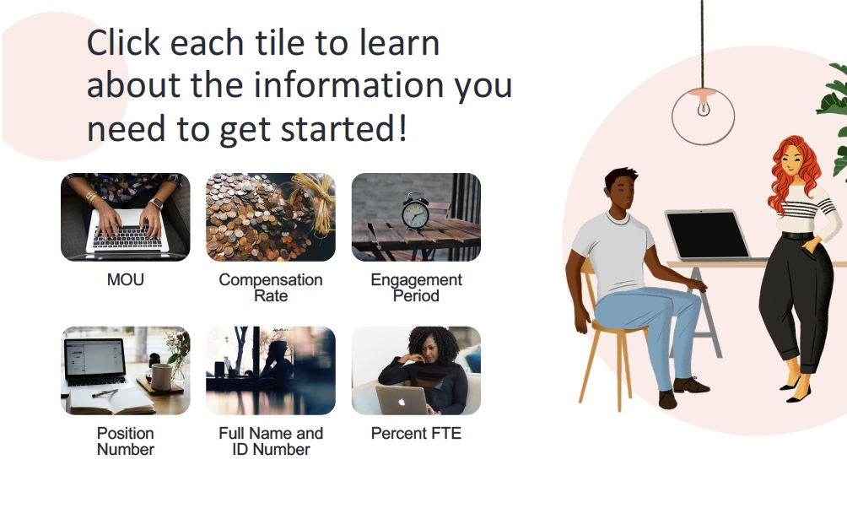
Date: | 10 October 2020
Course Name: | Working with Hiring and HR Systems
Module #: | 3
Module Section Title (Subtopic): | Hiring a Faculty Member
Slide/Screen Title: | Click each tile to learn about the information you need to get started!
Navigation Notes: | Each tile leads to an explanation screen. Once all tiles have been read, a “next” button will appear.
Graphics and Slide Text:
Narration/Voiceover: Click each tile to learn about the information you need to get started!
Animation: The tiles should glow or pulse. One of the characters might gesture or wave.
Notes:
Clean Version

Slide 20

Date: | 10 October 2020
Course Name: | Working with Hiring and HR Systems
Module #: | 3
Module Section Title (Subtopic): | Hiring a Faculty Member
Slide/Screen Title: | MOU
Navigation Notes: | There will be a “return” button that takes learners back to the tile screen.
Graphics and Slide Text:
Narration/Voiceover: N/A
Animation: CEETL Beetle might scurry across the scene to its place on the laptop. Background circle could pop, while text slides from left.
Notes:
Clean Version

Slide 21
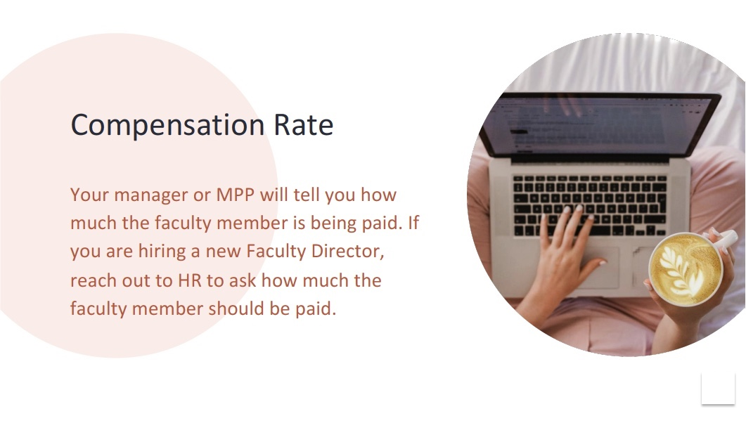
Date: | 10 October 2020
Course Name: | Working with Hiring and HR Systems
Module #: | 3
Module Section Title (Subtopic): | Hiring a Faculty Member
Slide/Screen Title: | Compensation Rate
Navigation Notes: | There will be a “return” button that takes learners back to the tile screen.
Graphics and Slide Text:
Narration/Voiceover: N/A
Animation: CEETL Beetle might scurry across the scene to its place on the laptop. Background circle could pop, while text slides from left.
Notes:
Clean Version

Slide 22
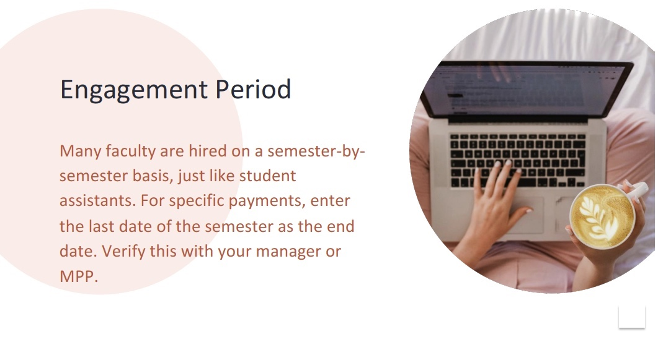
Date: | 10 October 2020
Course Name: | Working with Hiring and HR Systems
Module #: | 3
Module Section Title (Subtopic): | Hiring a Faculty Member
Slide/Screen Title: | Engagement Period
Navigation Notes: | There will be a “return” button that takes learners back to the tile screen.
Graphics and Slide Text:
Narration/Voiceover: N/A
Animation: CEETL Beetle might scurry across the scene to its place on the laptop. Background circle could pop, while text slides from left.
Notes:
Clean Version

Slide 23
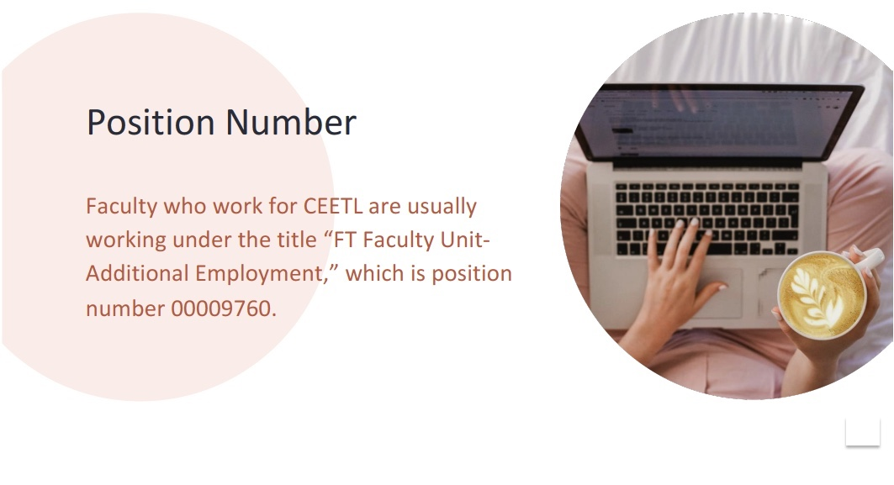
Date: | 10 October 2020
Course Name: | Working with Hiring and HR Systems
Module #: | 3
Module Section Title (Subtopic): | Hiring a Faculty Member
Slide/Screen Title: | Position Number
Navigation Notes: | There will be a “return” button that takes learners back to the tile screen.
Graphics and Slide Text:
Narration/Voiceover: N/A
Animation: CEETL Beetle might scurry across the scene to its place on the laptop. Background circle could pop, while text slides from left.
Notes:
Clean Version

Slide 24
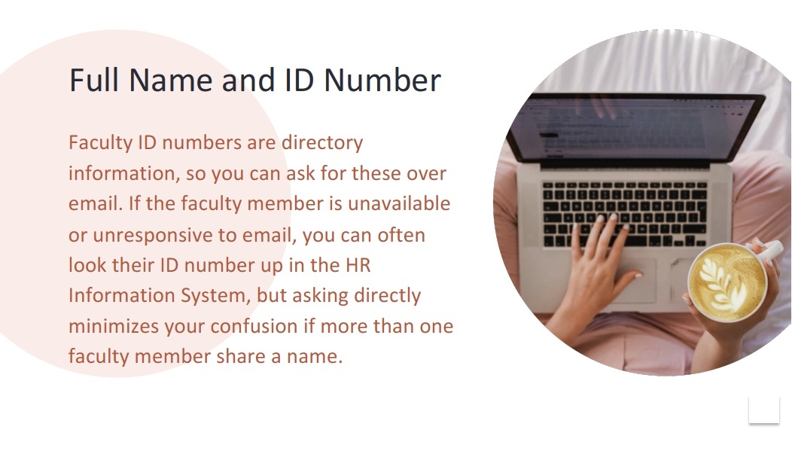
Date: | 10 October 2020
Course Name: | Working with Hiring and HR Systems
Module #: | 3
Module Section Title (Subtopic): | Hiring a Faculty Member
Slide/Screen Title: | Full Name and ID Number
Navigation Notes: | There will be a “return” button that takes learners back to the tile screen.
Graphics and Slide Text:
Narration/Voiceover: N/A
Animation: CEETL Beetle might scurry across the scene to its place on the laptop. Background circle could pop, while text slides from left.
Notes:
Clean Version

Slide 25
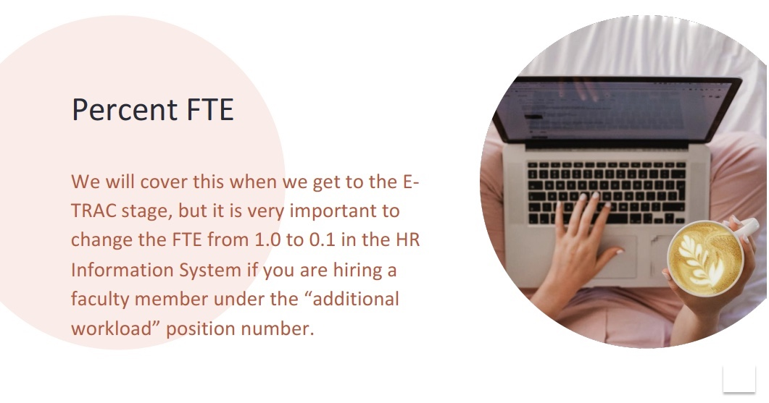
Date: | 10 October 2020
Course Name: | Working with Hiring and HR Systems
Module #: | 3
Module Section Title (Subtopic): | Hiring a Faculty Member
Slide/Screen Title: | Percent FTE
Navigation Notes: | There will be a “return” button that takes learners back to the tile screen.
Graphics and Slide Text:
Narration/Voiceover: N/A
Animation: CEETL Beetle might scurry across the scene to its place on the laptop. Background circle could pop, while text slides from left.
Notes:
Clean Version

Slide 26
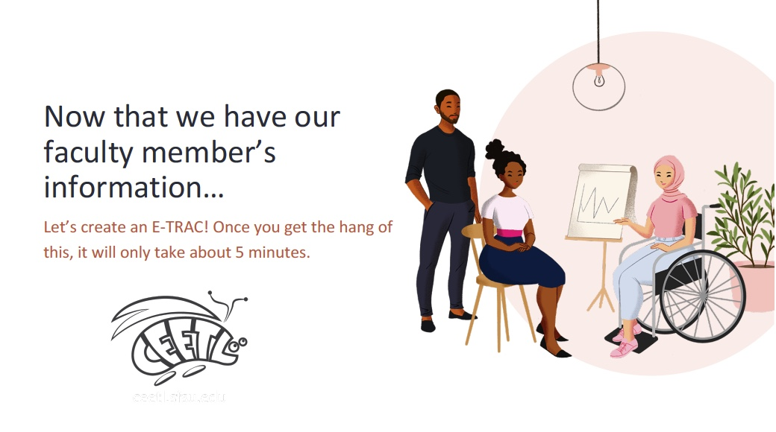
Date: | 10 October 2020
Course Name: | Working with Hiring and HR Systems
Module #: | 3
Module Section Title (Subtopic): | Hiring a Faculty Member
Slide/Screen Title: | Let’s create an E-TRAC
Navigation Notes: | The CEETL Beetle will act as a “next” button.
Graphics and Slide Text:
Narration/Voiceover: Now you’re ready to see an E-TRAC in action! Click the CEETL Beetle to see a video that walks you through a faculty additional workload E-TRAC.
Animation: One of the characters might wave or gesture. The CEETL Beetle should glow or pulse after scurrying in from left.
Notes:
Clean Version

Slide 27
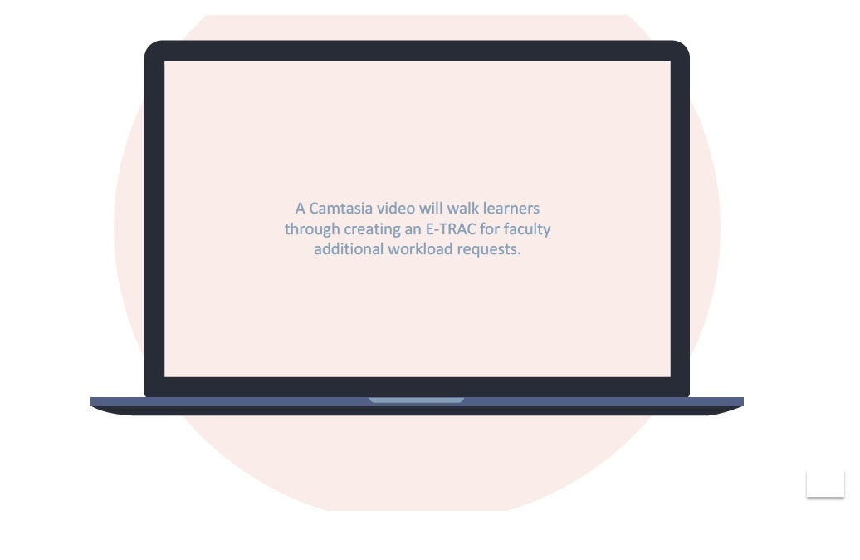
Date: | 10 October 2020
Course Name: | Working with Hiring and HR Systems
Module #: | 3
Module Section Title (Subtopic): | Hiring a Faculty Member
Slide/Screen Title: | Faculty Additional Workload Requests
Navigation Notes: | This video screen will have ”play” and “pause” buttons, as well as an “I’ve got it!” button that advances to the next slide.
Graphics and Slide Text:
Narration/Voiceover: N/A
Animation: N/A
Notes:
Clean Version

Slide 28
Date: | 10 October 2020
Course Name: | Working with Hiring and HR Systems
Module #: | 3
Module Section Title (Subtopic): | Hiring a Faculty Member
Slide/Screen Title: | Great work!
Navigation Notes: | The CEETL Beetle will act as a “next” button.
Graphics and Slide Text:
Narration/Voiceover: Now you’ve been introduced to faculty additional workload E-TRACs! Check your knowledge next.
Animation: One of the characters might wave or gesture. The CEETL Beetle should glow or pulse after scurrying in from left.
Notes:
Clean Version

Slide 29
Date: | 10 October 2020
Course Name: | Working with Hiring and HR Systems
Module #: | 3
Module Section Title (Subtopic): | Hiring a Faculty Member
Slide/Screen Title: | Knowledge Check
Navigation Notes: | Correct answers will appear green and automatically advance to the next question. Incorrect answers will appear red and automatically trigger an explanation and invitation to try again. The last question will automatically advance to the Hiring Menu.
Graphics and Slide Text:
Narration/Voiceover: N/A
Animation: Text slides in from left. Right answers glow green; wrong answers glow red.
Notes:
Clean Version

Slide 30
Date: | 10 October 2020
Course Name: | Working with Hiring and HR Systems
Module #: | 4
Module Section Title (Subtopic): | Hiring a Staff Member
Slide/Screen Title: | Who Would You Like to Work on Hiring Today?
Navigation Notes: | This is a branching homepage, where 5 tiles lead to different modules.
Graphics and Slide Text:
Narration/Voiceover: Who would you like to work on hiring today?
Animation: The clickable tiles glow or pulse.
Notes:
Clean Version

Slide 31
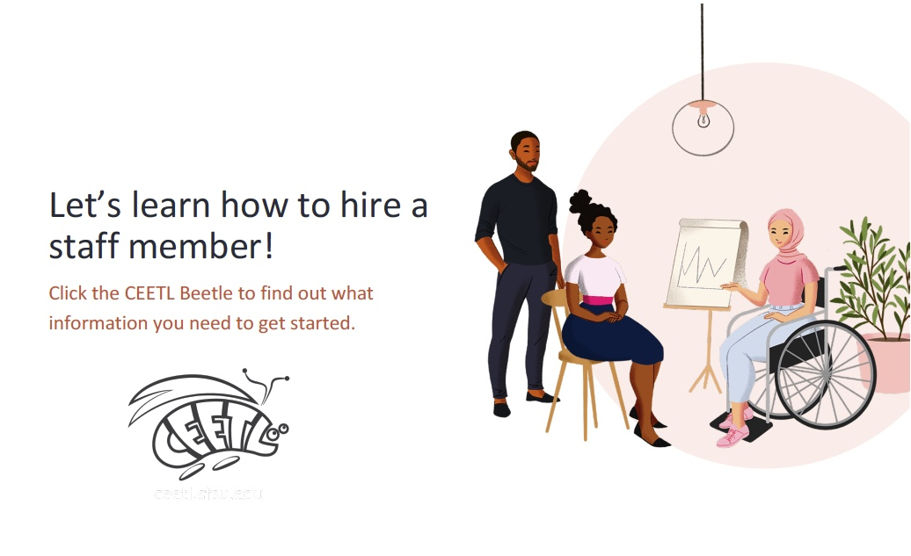
Date: | 10 October 2020
Course Name: | Working with Hiring and HR Systems
Module #: | 4
Module Section Title (Subtopic): | Hiring a Staff Member
Slide/Screen Title: | Let’s learn how to hire a staff member
Navigation Notes: | The CEETL Beetle will act as a “next” button.
Graphics and Slide Text:
Narration/Voiceover: You chose to learn about hiring a staff member! Before we learn how to process an E-TRAC, click the CEETL Beetle to learn more about what information you’ll need from a new staff member.
Animation: One of the characters might wave or gesture. The CEETL Beetle should glow or pulse after scurrying in from left.
Notes:
Clean Version

Slide 32
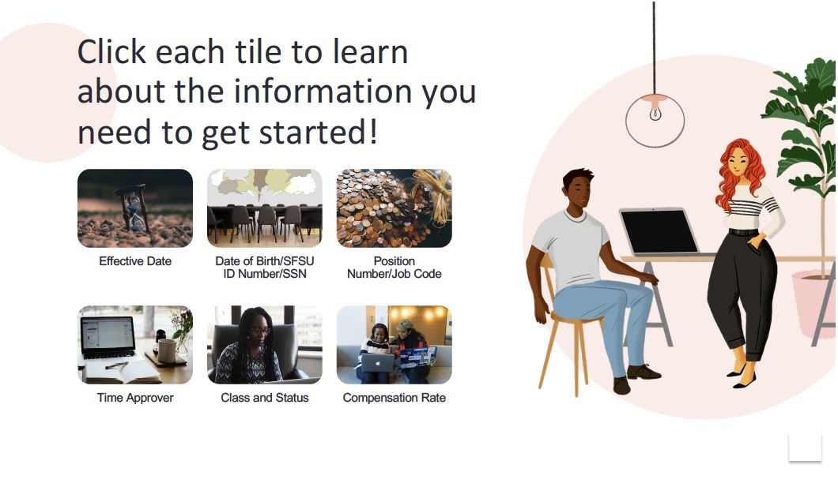
Date: | 10 October 2020
Course Name: | Working with Hiring and HR Systems
Module #: | 4
Module Section Title (Subtopic): | Hiring a Staff Member
Slide/Screen Title: | Click each tile to learn about the information you need to get started!
Navigation Notes: | Each tile leads to an explanation screen. Once all tiles have been read, a “next” button will appear.
Graphics and Slide Text:
Narration/Voiceover: Click each tile to learn about the information you need to get started!
Animation: The tiles should glow or pulse. One of the characters might gesture or wave.
Notes:
Clean Version

Slide 33
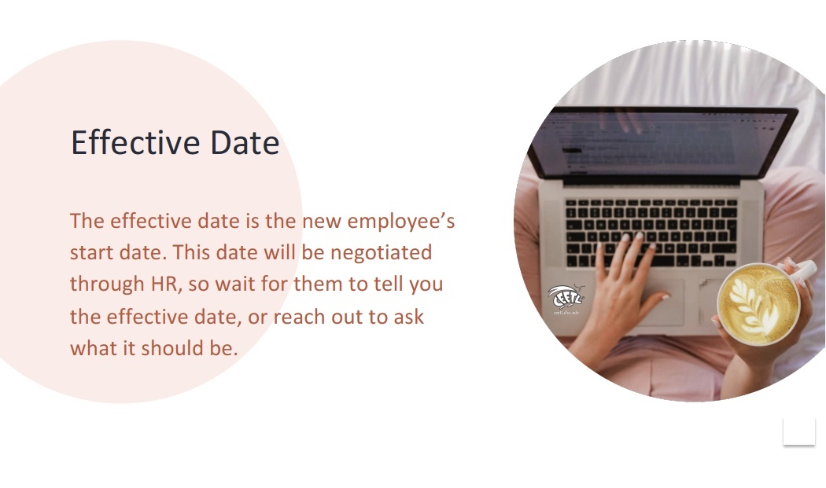
Date: | 10 October 2020
Course Name: | Working with Hiring and HR Systems
Module #: | 4
Module Section Title (Subtopic): | Hiring a Staff Member
Slide/Screen Title: | Effective Date
Navigation Notes: | There will be a “return” button that takes learners back to the tile screen.
Graphics and Slide Text:
Narration/Voiceover: N/A
Animation: CEETL Beetle might scurry across the scene to its place on the laptop. Background circle could pop, while text slides from left.
Notes:
Clean Version

Slide 34
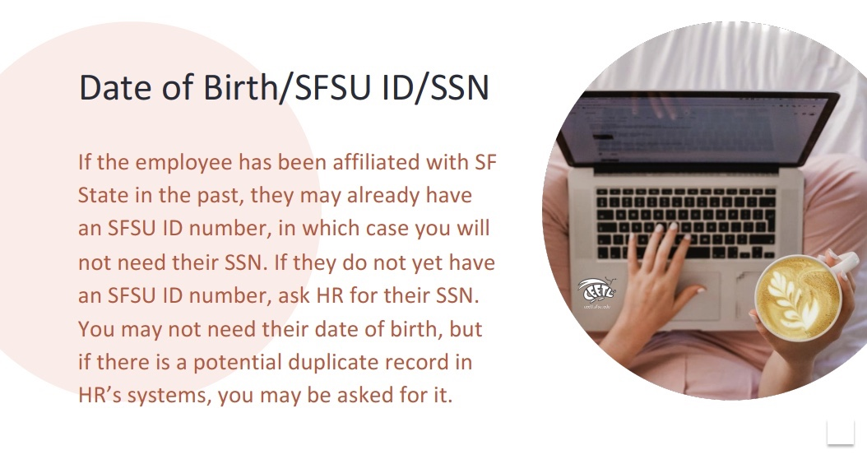
Date: | 10 October 2020
Course Name: | Working with Hiring and HR Systems
Module #: | 4
Module Section Title (Subtopic): | Hiring a Staff Member
Slide/Screen Title: | Date of Birth/SFSU ID/SSN
Navigation Notes: | There will be a “return” button that takes learners back to the tile screen.
Graphics and Slide Text:
Narration/Voiceover: N/A
Animation: CEETL Beetle might scurry across the scene to its place on the laptop. Background circle could pop, while text slides from left.
Notes:
Clean Version

Slide 35
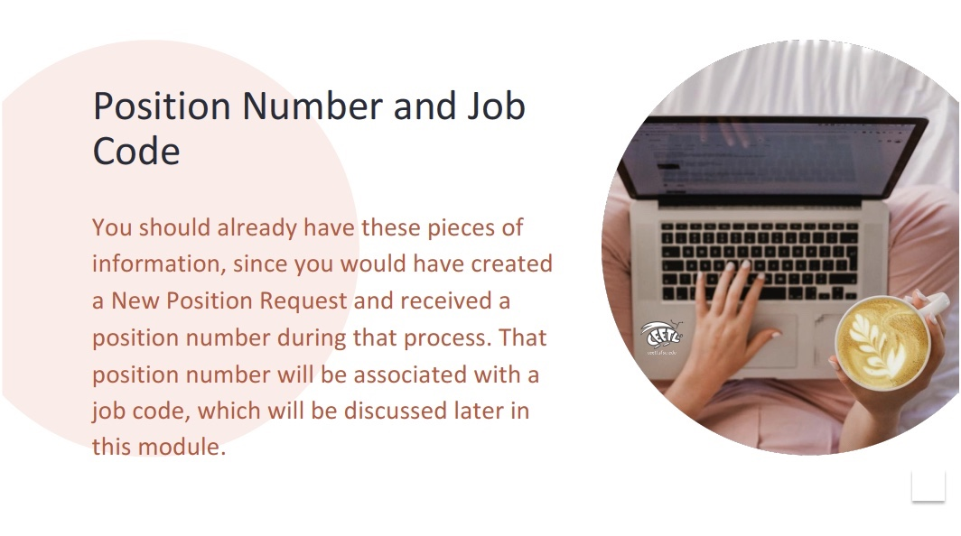
Date: | 10 October 2020
Course Name: | Working with Hiring and HR Systems
Module #: | 4
Module Section Title (Subtopic): | Hiring a Staff Member
Slide/Screen Title: | Position Number and Job Code
Navigation Notes: | There will be a “return” button that takes learners back to the tile screen.
Graphics and Slide Text:
Narration/Voiceover: N/A
Animation: CEETL Beetle might scurry across the scene to its place on the laptop. Background circle could pop, while text slides from left.
Notes:
Clean Version

Slide 36
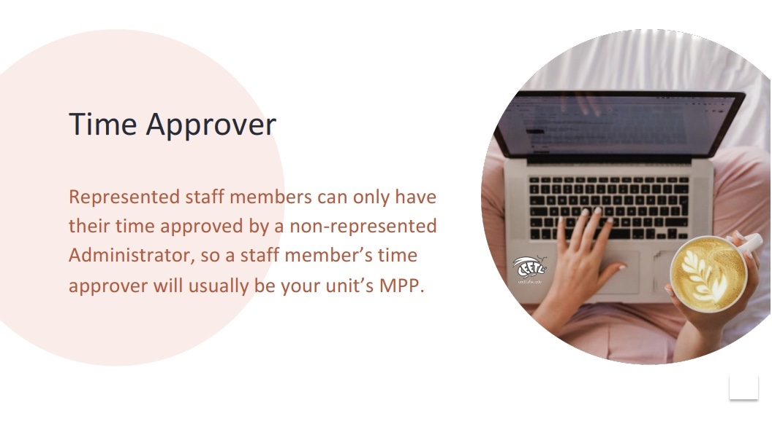
Date: | 10 October 2020
Course Name: | Working with Hiring and HR Systems
Module #: | 4
Module Section Title (Subtopic): | Hiring a Staff Member
Slide/Screen Title: | Time Approver
Navigation Notes: | There will be a “return” button that takes learners back to the tile screen.
Graphics and Slide Text:
Narration/Voiceover: N/A
Animation: CEETL Beetle might scurry across the scene to its place on the laptop. Background circle could pop, while text slides from left.
Notes:
Clean Version

Slide 37
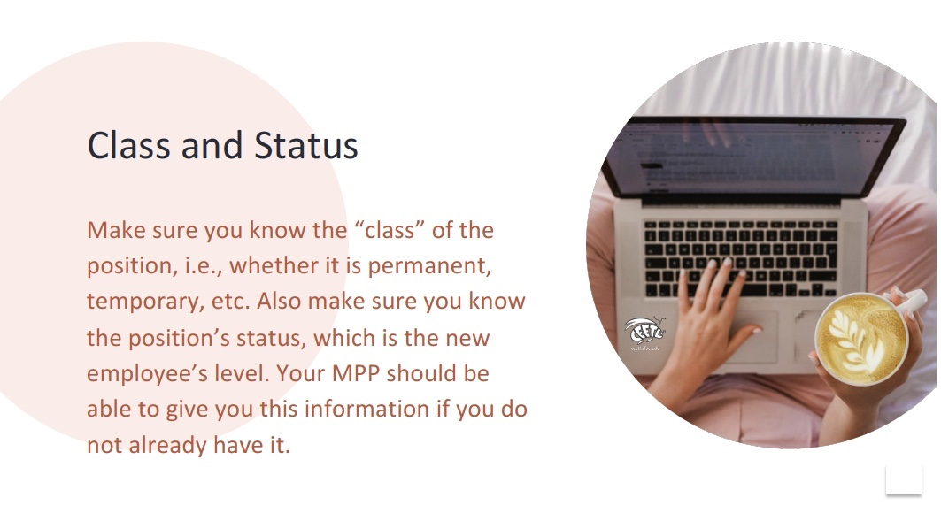
Date: | 10 October 2020
Course Name: | Working with Hiring and HR Systems
Module #: | 4
Module Section Title (Subtopic): | Hiring a Staff Member
Slide/Screen Title: | Class and Status
Navigation Notes: | There will be a “return” button that takes learners back to the tile screen.
Graphics and Slide Text:
Narration/Voiceover: N/A
Animation: CEETL Beetle might scurry across the scene to its place on the laptop. Background circle could pop, while text slides from left.
Notes:
Clean Version

Slide 38
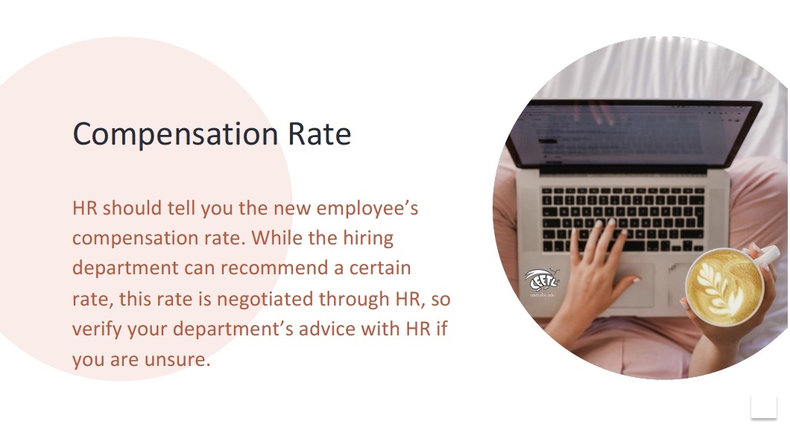
Date: | 10 October 2020
Course Name: | Working with Hiring and HR Systems
Module #: | 4
Module Section Title (Subtopic): | Hiring a Staff Member
Slide/Screen Title: | Compensation Rate
Navigation Notes: | There will be a “return” button that takes learners back to the tile screen.
Graphics and Slide Text:
Narration/Voiceover: N/A
Animation: CEETL Beetle might scurry across the scene to its place on the laptop. Background circle could pop, while text slides from left.
Notes:
Clean Version

Slide 39
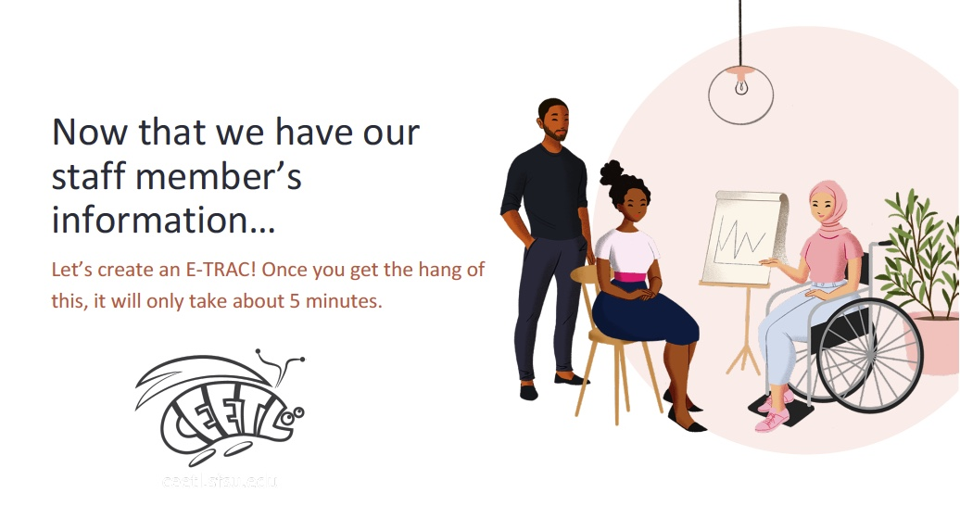
Date: | 10 October 2020
Course Name: | Working with Hiring and HR Systems
Module #: | 4
Module Section Title (Subtopic): | Hiring a Staff Member
Slide/Screen Title: | Let’s Create an E-TRAC
Navigation Notes: | The CEETL Beetle will act as a “next” button.
Graphics and Slide Text:
Narration/Voiceover: Now you’re ready to see an E-TRAC in action! Click the CEETL Beetle to see a video that walks you through a new hire E-TRAC.
Animation: One of the characters might wave or gesture. The CEETL Beetle should glow or pulse after scurrying in from left.
Notes:
Clean Version

Slide 40
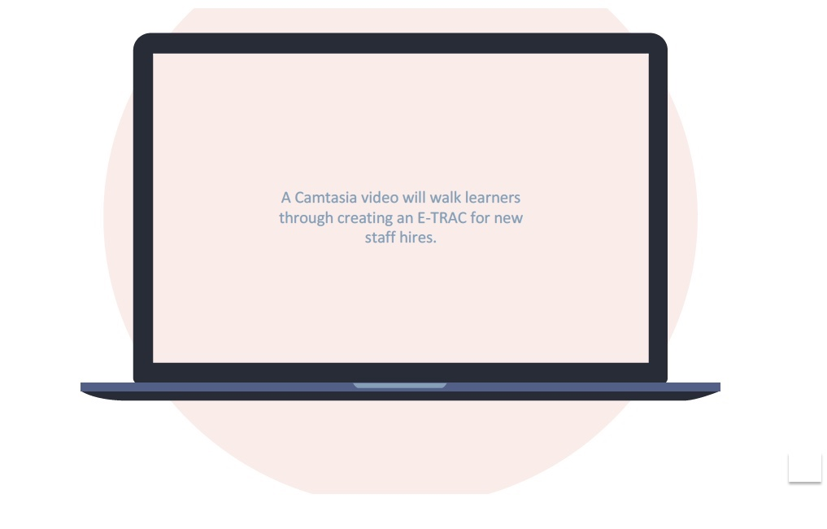
Date: | 10 October 2020
Course Name: | Working with Hiring and HR Systems
Module #: | 4
Module Section Title (Subtopic): | Hiring a Staff Member
Slide/Screen Title: | New Hire E-TRACs
Navigation Notes: | This video screen will have ”play” and “pause” buttons, as well as an “I’ve got it!” button that advances to the next slide.
Graphics and Slide Text:
Narration/Voiceover: N/A
Animation: N/A
Notes:
Clean Version

Slide 41
Date: | 10 October 2020
Course Name: | Working with Hiring and HR Systems
Module #: | 4
Module Section Title (Subtopic): | Hiring a Staff Member
Slide/Screen Title: | Great work!
Navigation Notes: | The CEETL Beetle will act as a “next” button.
Graphics and Slide Text:
Narration/Voiceover: Now you’ve been introduced to new hire E-TRACs! Check your knowledge next.
Animation: One of the characters might wave or gesture. The CEETL Beetle should glow or pulse after scurrying in from left.
Notes:
Clean Version

Slide 42
Date: | 10 October 2020
Course Name: | Working with Hiring and HR Systems
Module #: | 4
Module Section Title (Subtopic): | Hiring a Staff Member
Slide/Screen Title: | Knowledge Check
Navigation Notes: | Correct answers will appear green and automatically advance to the next question. Incorrect answers will appear red and automatically trigger an explanation and invitation to try again. The last question will automatically advance to the Hiring Menu.
Graphics and Slide Text:
Narration/Voiceover: N/A
Animation: Text slides in from left. Right answers glow green; wrong answers glow red.
Notes:
Clean Version

Slide 43
Date: | 10 October 2020
Course Name: | Working with Hiring and HR Systems
Module #: | 5
Module Section Title (Subtopic): | Requesting a New Position
Slide/Screen Title: | Who Would You Like to Work on Hiring Today?
Navigation Notes: | This is a branching homepage, where 5 tiles lead to different modules.
Graphics and Slide Text:
Narration/Voiceover: Who would you like to work on hiring today?
Animation: The clickable tiles glow or pulse.
Notes:
Clean Version

Slide 44
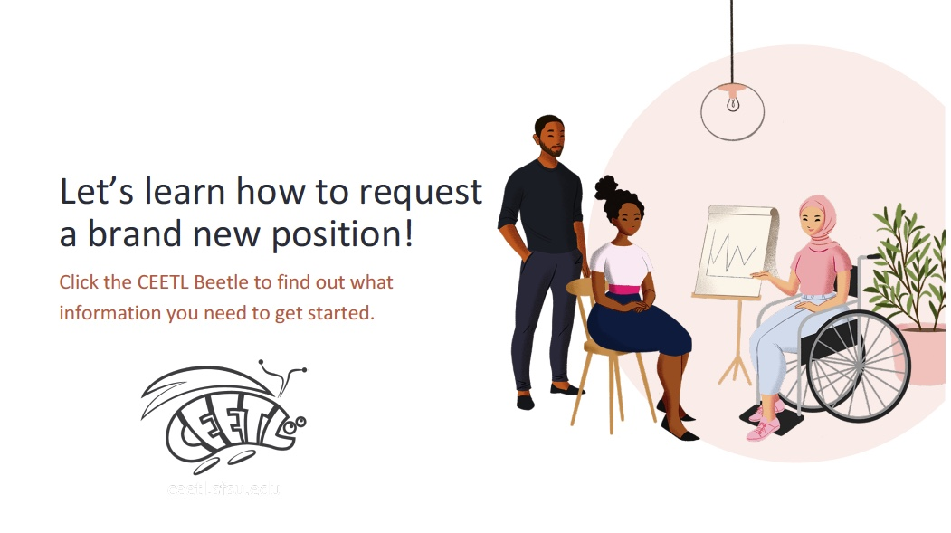
Date: | 10 October 2020
Course Name: | Working with Hiring and HR Systems
Module #: | 5
Module Section Title (Subtopic): | Requesting a New Position
Slide/Screen Title: | Let’s learn how to request a new position
Navigation Notes: | The CEETL Beetle will act as a “next” button.
Graphics and Slide Text:
Narration/Voiceover: You chose to learn about new position requests! Before we learn how to process an E-TRAC, click the CEETL Beetle to learn more about what information you’ll need from your MPP in order to process a New Position Request.
Animation: One of the characters might wave or gesture. The CEETL Beetle should glow or pulse after scurrying in from left.
Notes:
Clean Version

Slide 45
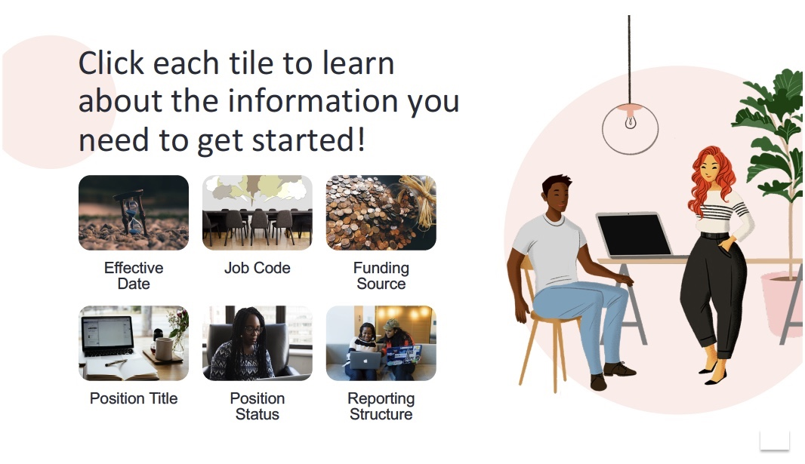
Date: | 10 October 2020
Course Name: | Working with Hiring and HR Systems
Module #: | 5
Module Section Title (Subtopic): | Requesting a New Position
Slide/Screen Title: | Click each tile to learn about the information you need to get started!
Navigation Notes: | Each tile leads to an explanation screen. Once all tiles have been read, a “next” button will appear.
Graphics and Slide Text:
Narration/Voiceover: Click each tile to learn about the information you need to get started!
Animation: The tiles should glow or pulse. One of the characters might gesture or wave.
Notes:
Clean Version

Slide 46
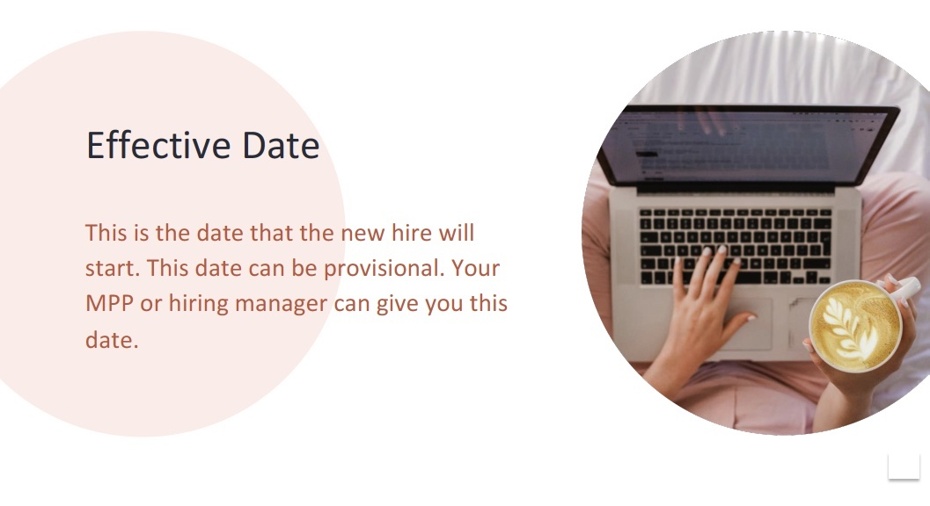
Date: | 10 October 2020
Course Name: | Working with Hiring and HR Systems
Module #: | 5
Module Section Title (Subtopic): | Requesting a New Position
Slide/Screen Title: | Effective Date
Navigation Notes: | There will be a “return” button that takes learners back to the tile screen.
Graphics and Slide Text:
Narration/Voiceover: N/A
Animation: CEETL Beetle might scurry across the scene to its place on the laptop. Background circle could pop, while text slides from left.
Notes:
Clean Version

Slide 47
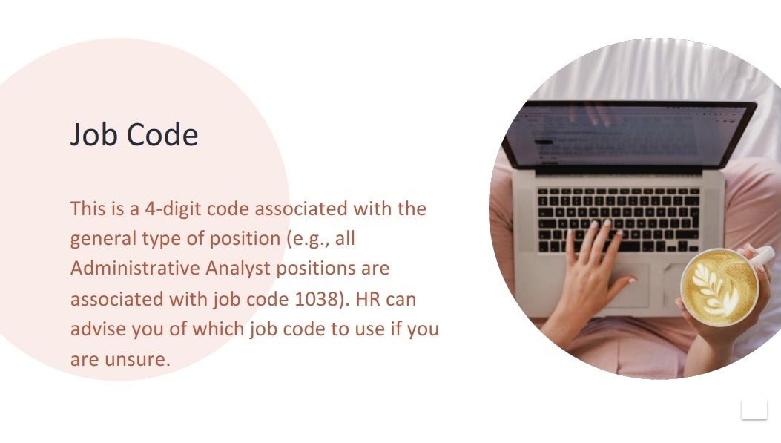
Date: | 10 October 2020
Course Name: | Working with Hiring and HR Systems
Module #: | 5
Module Section Title (Subtopic): | Requesting a New Position
Slide/Screen Title: | Job Code
Navigation Notes: | There will be a “return” button that takes learners back to the tile screen.
Graphics and Slide Text:
Narration/Voiceover: N/A
Animation: CEETL Beetle might scurry across the scene to its place on the laptop. Background circle could pop, while text slides from left.
Notes:
Clean Version

Slide 48
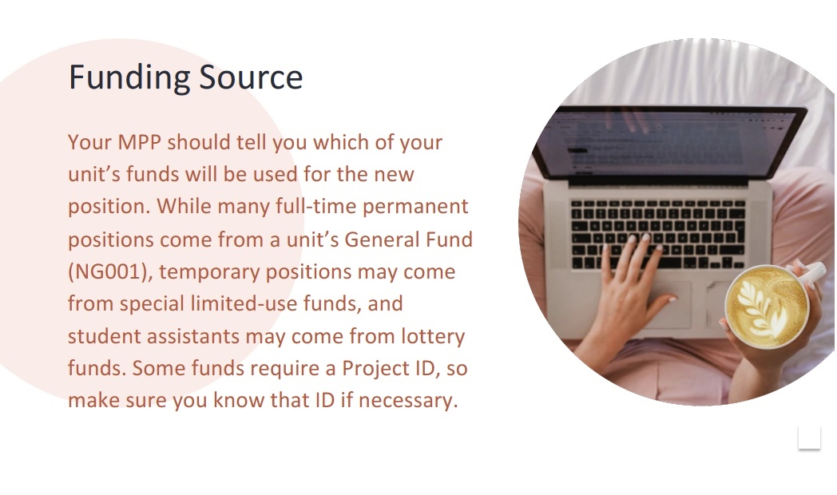
Date: | 10 October 2020
Course Name: | Working with Hiring and HR Systems
Module #: | 5
Module Section Title (Subtopic): | Requesting a New Position
Slide/Screen Title: | Funding Source
Navigation Notes: | There will be a “return” button that takes learners back to the tile screen.
Graphics and Slide Text:
Narration/Voiceover: N/A
Animation: CEETL Beetle might scurry across the scene to its place on the laptop. Background circle could pop, while text slides from left.
Notes:
Clean Version

Slide 49

Date: | 10 October 2020
Course Name: | Working with Hiring and HR Systems
Module #: | 5
Module Section Title (Subtopic): | Requesting a New Position
Slide/Screen Title: | Position Title
Navigation Notes: | There will be a “return” button that takes learners back to the tile screen.
Graphics and Slide Text:
Narration/Voiceover: N/A
Animation: CEETL Beetle might scurry across the scene to its place on the laptop. Background circle could pop, while text slides from left.
Notes:
Clean Version

Slide 50
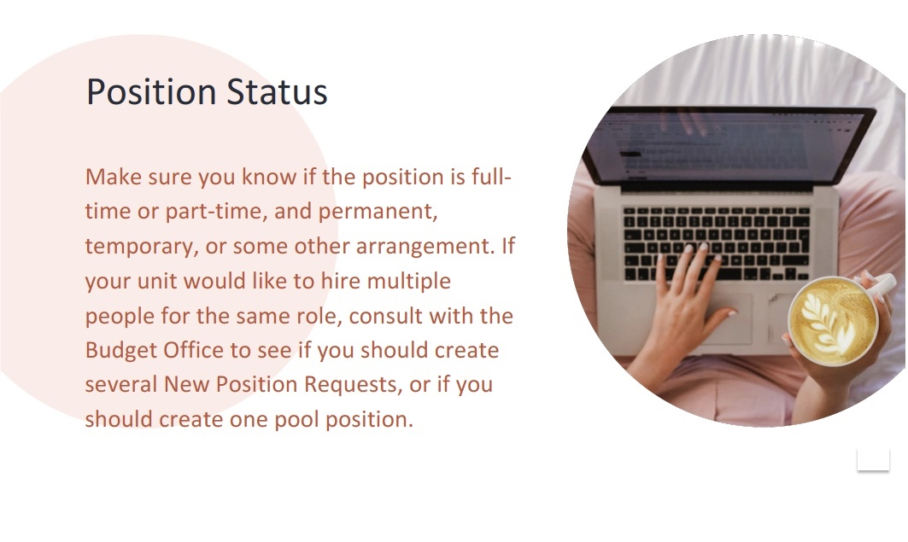
Date: | 10 October 2020
Course Name: | Working with Hiring and HR Systems
Module #: | 5
Module Section Title (Subtopic): | Requesting a New Position
Slide/Screen Title: | Position Status
Navigation Notes: | There will be a “return” button that takes learners back to the tile screen.
Graphics and Slide Text:
Narration/Voiceover: N/A
Animation: CEETL Beetle might scurry across the scene to its place on the laptop. Background circle could pop, while text slides from left.
Notes:
Clean Version

Slide 51
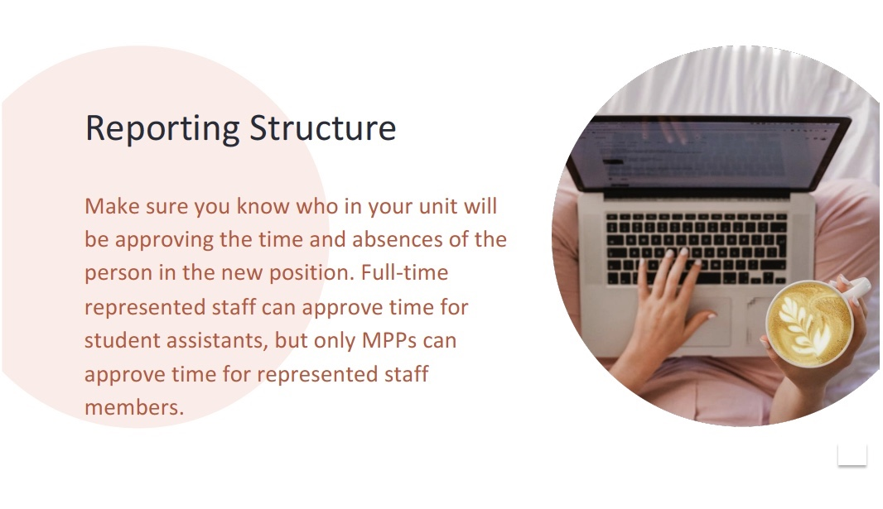
Date: | 10 October 2020
Course Name: | Working with Hiring and HR Systems
Module #: | 5
Module Section Title (Subtopic): | Requesting a New Position
Slide/Screen Title: | Reporting Structure
Navigation Notes: | There will be a “return” button that takes learners back to the tile screen.
Graphics and Slide Text:
Narration/Voiceover: N/A
Animation: CEETL Beetle might scurry across the scene to its place on the laptop. Background circle could pop, while text slides from left.
Notes:
Clean Version

Slide 52
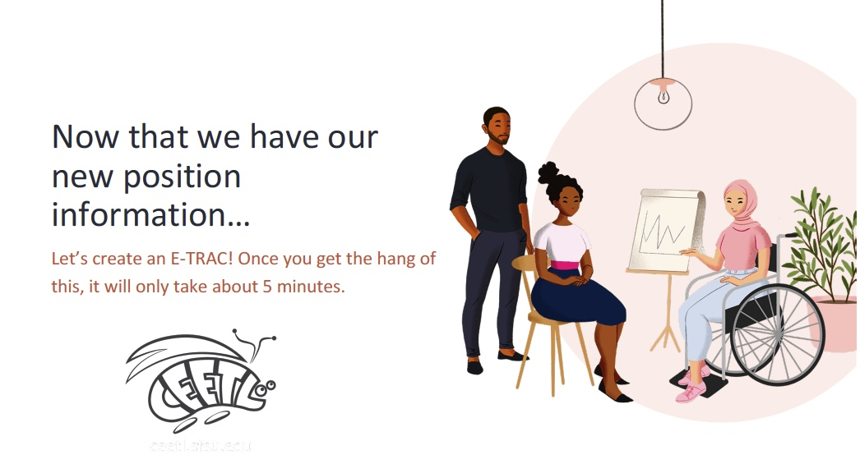
Date: | 10 October 2020
Course Name: | Working with Hiring and HR Systems
Module #: | 5
Module Section Title (Subtopic): | Requesting a New Position
Slide/Screen Title: | Let’s Create an E-TRAC
Navigation Notes: | The CEETL Beetle will act as a “next” button.
Graphics and Slide Text:
Narration/Voiceover: Now you’re ready to see an E-TRAC in action! Click the CEETL Beetle to see a video that walks you through a New Position Request E-TRAC.
Animation: One of the characters might wave or gesture. The CEETL Beetle should glow or pulse after scurrying in from left.
Notes:
Clean Version

Slide 53
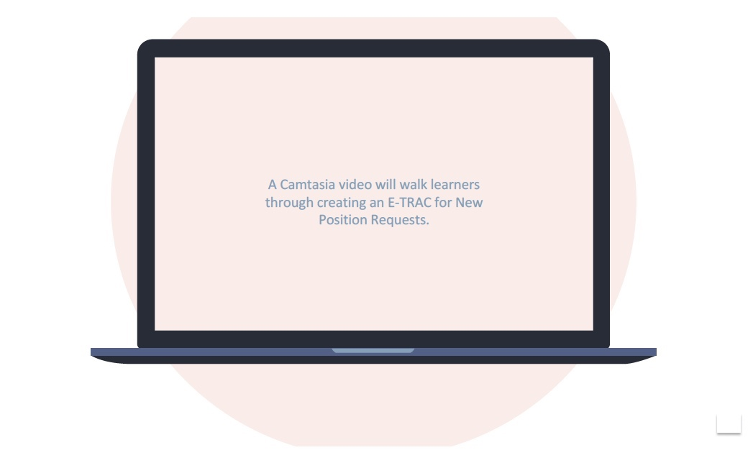
Date: | 10 October 2020
Course Name: | Working with Hiring and HR Systems
Module #: | 5
Module Section Title (Subtopic): | Requesting a New Position
Slide/Screen Title: | New Position Request E-TRACs
Navigation Notes: | This video screen will have ”play” and “pause” buttons, as well as an “I’ve got it!” button that advances to the next slide.
Graphics and Slide Text:
Narration/Voiceover: N/A
Animation: N/A
Notes:
Clean Version

Slide 54
Date: | 10 October 2020
Course Name: | Working with Hiring and HR Systems
Module #: | 5
Module Section Title (Subtopic): | Requesting a New Position
Slide/Screen Title: | Great work!
Navigation Notes: | The CEETL Beetle will act as a “next” button.
Graphics and Slide Text:
Narration/Voiceover: Now you’ve been introduced to New Position Request E-TRACs! Check your knowledge next.
Animation: One of the characters might wave or gesture. The CEETL Beetle should glow or pulse after scurrying in from left.
Notes:
Clean Version

Slide 55
Date: | 10 October 2020
Course Name: | Working with Hiring and HR Systems
Module #: | 5
Module Section Title (Subtopic): | Requesting a New Position
Slide/Screen Title: | Knowledge Check
Navigation Notes: | Correct answers will appear green and automatically advance to the next question. Incorrect answers will appear red and automatically trigger an explanation and invitation to try again. The last question will automatically advance to the Hiring Menu.
Graphics and Slide Text:
Narration/Voiceover: N/A
Animation: Text slides in from left. Right answers glow green; wrong answers glow red.
Notes:
Clean Version

Slide 56
Date: | 10 October 2020
Course Name: | Working with Hiring and HR Systems
Module #: | 6
Module Section Title (Subtopic): | Recruiting a New Employee
Slide/Screen Title: | Who Would You Like to Work on Hiring Today?
Navigation Notes: | This is a branching homepage, where 5 tiles lead to different modules.
Graphics and Slide Text:
Narration/Voiceover: Who would you like to work on hiring today?
Animation: The clickable tiles glow or pulse.
Notes:
Clean Version

Slide 57

Date: | 10 October 2020
Course Name: | Working with Hiring and HR Systems
Module #: | 6
Module Section Title (Subtopic): | Recruiting a New Employee
Slide/Screen Title: | Let’s learn how to recruit new employees
Navigation Notes: | The CEETL Beetle will act as a “next” button.
Graphics and Slide Text:
Narration/Voiceover: You chose to learn about recruiting new employees! Before we learn how to process an E-TRAC, click the CEETL Beetle to learn more about what information you’ll need from your MPP in order to recruit new employees.
Animation: One of the characters might wave or gesture. The CEETL Beetle should glow or pulse after scurrying in from left.
Notes:
Clean Version

Slide 58
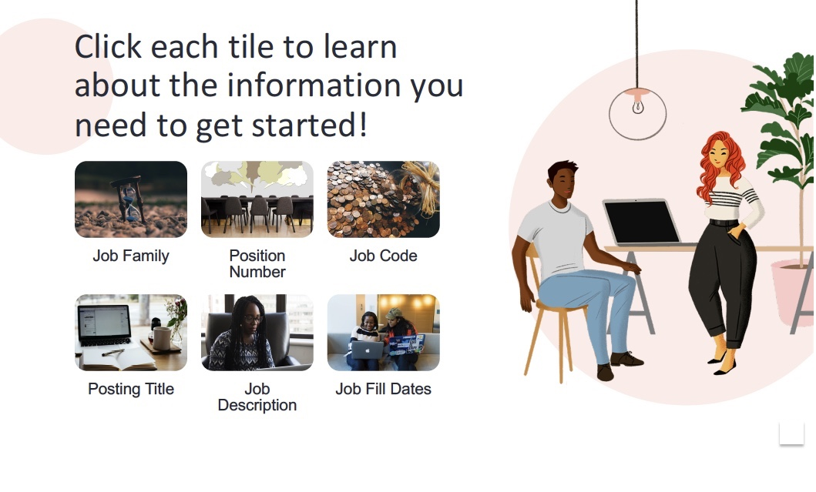
Date: | 10 October 2020
Course Name: | Working with Hiring and HR Systems
Module #: | 6
Module Section Title (Subtopic): | Recruiting a New Employee
Slide/Screen Title: | Click each tile to learn about the information you need to get started!
Navigation Notes: | Each tile leads to an explanation screen. Once all tiles have been read, a “next” button will appear.
Graphics and Slide Text:
Narration/Voiceover: Click each tile to learn about the information you need to get started!
Animation: The tiles should glow or pulse. One of the characters might gesture or wave.
Notes:
Clean Version

Slide 59
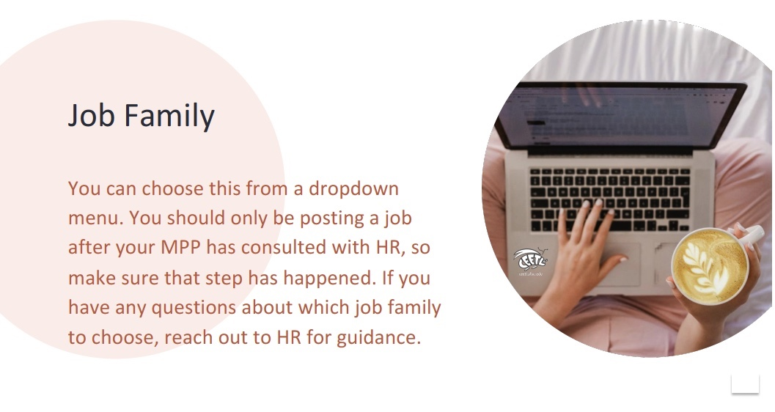
Date: | 10 October 2020
Course Name: | Working with Hiring and HR Systems
Module #: | 6
Module Section Title (Subtopic): | Recruiting a New Employee
Slide/Screen Title: | Job Family
Navigation Notes: | There will be a “return” button that takes learners back to the tile screen.
Graphics and Slide Text:
Narration/Voiceover: N/A
Animation: CEETL Beetle might scurry across the scene to its place on the laptop. Background circle could pop, while text slides from left.
Notes:
Clean Version

Slide 60
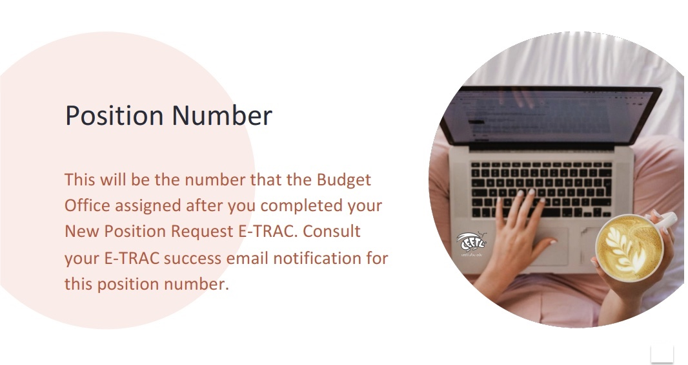
Date: | 10 October 2020
Course Name: | Working with Hiring and HR Systems
Module #: | 6
Module Section Title (Subtopic): | Recruiting a New Employee
Slide/Screen Title: | Position Number
Navigation Notes: | There will be a “return” button that takes learners back to the tile screen.
Graphics and Slide Text:
Narration/Voiceover: N/A
Animation: CEETL Beetle might scurry across the scene to its place on the laptop. Background circle could pop, while text slides from left.
Notes:
Clean Version

Slide 61
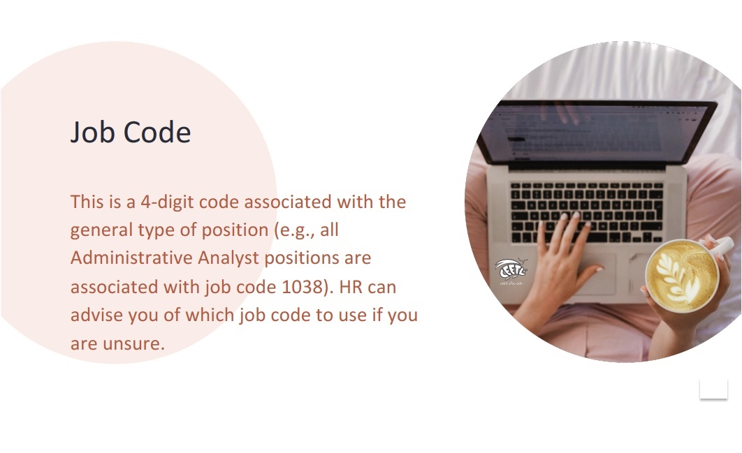
Date: | 10 October 2020
Course Name: | Working with Hiring and HR Systems
Module #: | 6
Module Section Title (Subtopic): | Recruiting a New Employee
Slide/Screen Title: | Job Code
Navigation Notes: | There will be a “return” button that takes learners back to the tile screen.
Graphics and Slide Text:
Narration/Voiceover: N/A
Animation: CEETL Beetle might scurry across the scene to its place on the laptop. Background circle could pop, while text slides from left.
Notes:
Clean Version

Slide 62
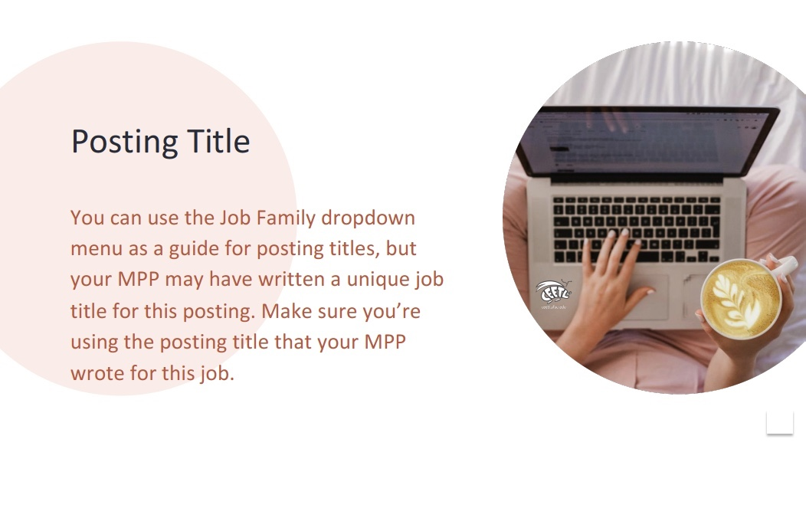
Date: | 10 October 2020
Course Name: | Working with Hiring and HR Systems
Module #: | 6
Module Section Title (Subtopic): | Recruiting a New Employee
Slide/Screen Title: | Posting Title
Navigation Notes: | There will be a “return” button that takes learners back to the tile screen.
Graphics and Slide Text:
Narration/Voiceover: N/A
Animation: CEETL Beetle might scurry across the scene to its place on the laptop. Background circle could pop, while text slides from left.
Notes:
Clean Version

Slide 63

Date: | 10 October 2020
Course Name: | Working with Hiring and HR Systems
Module #: | 6
Module Section Title (Subtopic): | Recruiting a New Employee
Slide/Screen Title: | Job Description
Navigation Notes: | There will be a “return” button that takes learners back to the tile screen.
Graphics and Slide Text:
Narration/Voiceover: N/A
Animation: CEETL Beetle might scurry across the scene to its place on the laptop. Background circle could pop, while text slides from left.
Notes:
Clean Version

Slide 64
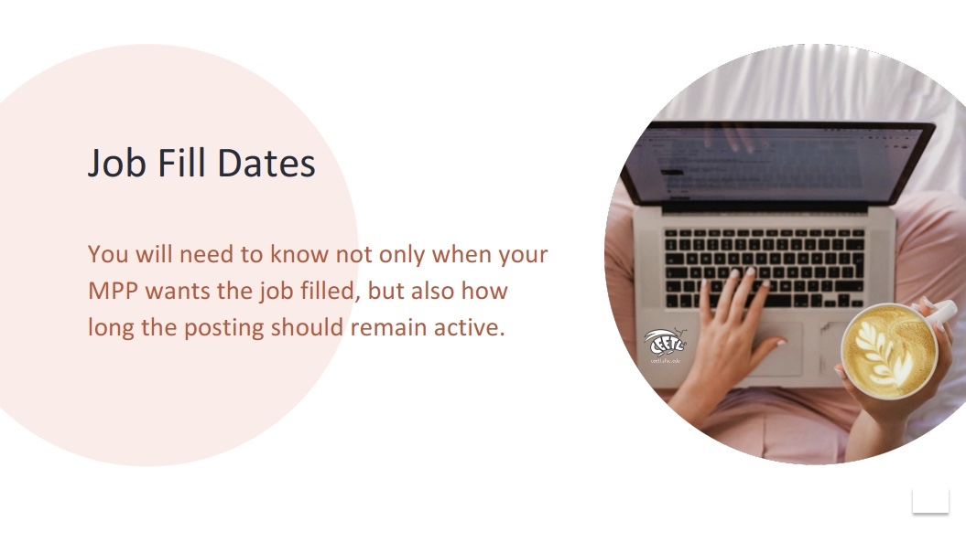
Date: | 10 October 2020
Course Name: | Working with Hiring and HR Systems
Module #: | 6
Module Section Title (Subtopic): | Recruiting a New Employee
Slide/Screen Title: | Job Fill Dates
Navigation Notes: | There will be a “return” button that takes learners back to the tile screen.
Graphics and Slide Text:
Narration/Voiceover: N/A
Animation: CEETL Beetle might scurry across the scene to its place on the laptop. Background circle could pop, while text slides from left.
Notes:
Clean Version

Slide 65
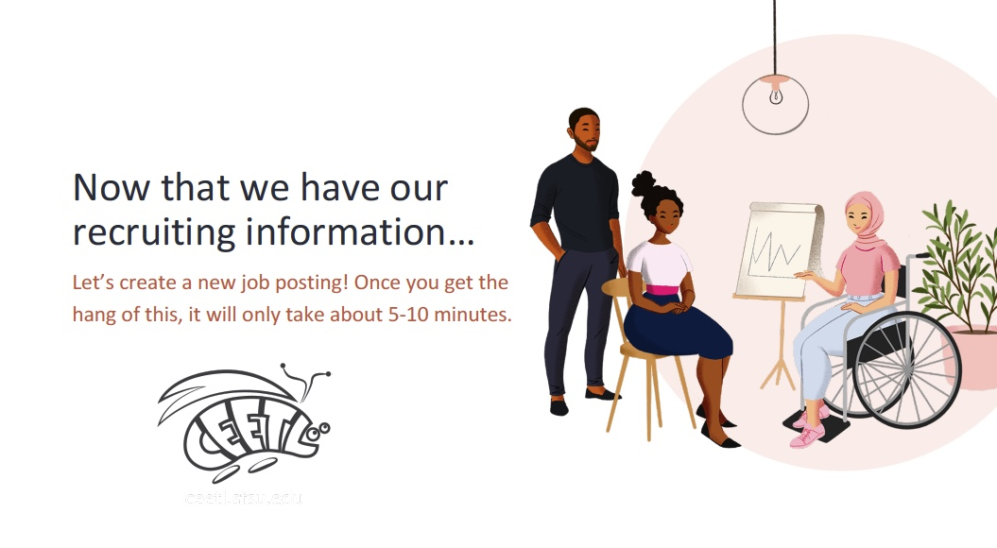
Date: | 10 October 2020
Course Name: | Working with Hiring and HR Systems
Module #: | 6
Module Section Title (Subtopic): | Recruiting a New Employee
Slide/Screen Title: | Let’s Create a Job Posting
Navigation Notes: | The CEETL Beetle will act as a “next” button.
Graphics and Slide Text:
Narration/Voiceover: Now you’re ready to see an E-TRAC in action! Click the CEETL Beetle to see a video that walks you through creating a job posting.
Animation: One of the characters might wave or gesture. The CEETL Beetle should glow or pulse after scurrying in from left.
Notes:
Clean Version

Slide 66
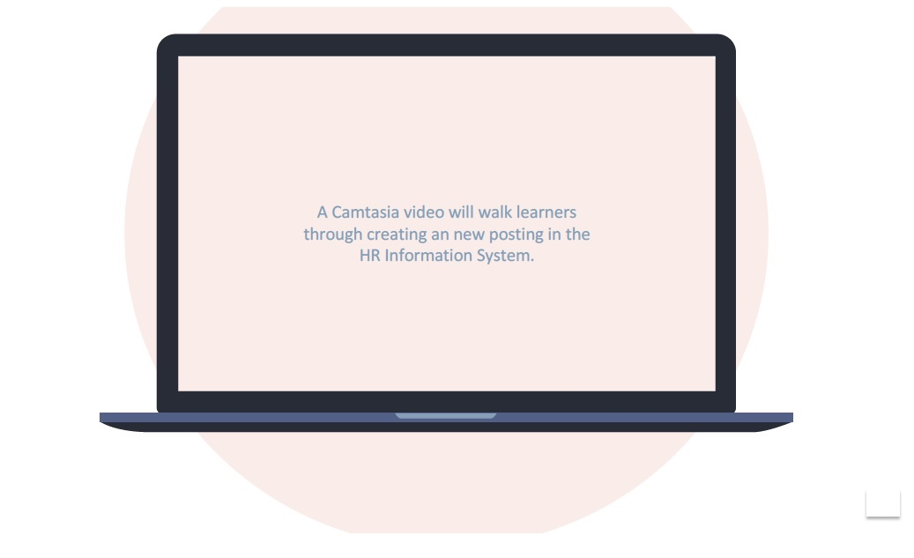
Date: | 10 October 2020
Course Name: | Working with Hiring and HR Systems
Module #: | 6
Module Section Title (Subtopic): | Recruiting a New Employee
Slide/Screen Title: | Creating a New Posting
Navigation Notes: | This video screen will have ”play” and “pause” buttons, as well as an “I’ve got it!” button that advances to the next slide.
Graphics and Slide Text:
Narration/Voiceover: N/A
Animation: N/A
Notes:
Clean Version

Slide 67
Date: | 10 October 2020
Course Name: | Working with Hiring and HR Systems
Module #: | 6
Module Section Title (Subtopic): | Recruiting a New Employee
Slide/Screen Title: | Great work!
Navigation Notes: | The CEETL Beetle will act as a “next” button.
Graphics and Slide Text:
Narration/Voiceover: Now you’ve been introduced to posting new jobs! Check your knowledge next.
Animation: One of the characters might wave or gesture. The CEETL Beetle should glow or pulse after scurrying in from left.
Notes:
Clean Version

Slide 68
Date: | 10 October 2020
Course Name: | Working with Hiring and HR Systems
Module #: | 6
Module Section Title (Subtopic): | Recruiting a New Employee
Slide/Screen Title: | Knowledge Check
Navigation Notes: | Correct answers will appear green and automatically advance to the next question. Incorrect answers will appear red and automatically trigger an explanation and invitation to try again. The last question will automatically advance to the Hiring Menu.
Graphics and Slide Text:
Narration/Voiceover: N/A
Animation: Text slides in from left. Right answers glow green; wrong answers glow red.
Notes:
Clean Version

Slide 69
Date: | 10 October 2020
Course Name: | Working with Hiring and HR Systems
Module #: | Back to Intro
Module Section Title (Subtopic): | Main Menu
Slide/Screen Title: | Who Would You Like to Work on Hiring Today?
Navigation Notes: | This is a branching homepage, where 5 tiles lead to different modules.
Graphics and Slide Text:
Narration/Voiceover: Who would you like to work on hiring today?
Animation: The clickable tiles glow or pulse.
Notes:
Clean Version

